Slide 1

Using Talend Open Studio for DaaS
David Sietz
Software Developer / Architect
Reference Material
https://github.com/dsietz/daas

Slide 2
1
DaaS architecture
2
reusable jobs
3
sourcing
4
provisioning
5
consuming

Slide 3
1
DaaS architecture
2
reusable jobs
3
sourcing
4
provisioning
5
consuming

Slide 4

client request
client request
client request
api layer
service
component
service
component
service
component
service
component
service
component
module
module
module
module
module
message broker
service
component
service
component
service
component
service
component
module
module
module
module

Slide 5
client request
client request
client request
api layer
service
component
service
component
service
component
service
component
service
component
module
module
module
module
module
message broker
service
component
service
component
service
component
service
component
module
module
module
module

Slide 6
client request
client request
client request
api layer
service
component
service
component
service
component
service
component
service
component
module
module
module
module
module
message broker
service
component
service
component
service
component
service
component
module
module
module
module

Slide 7
client request
client request
client request
api layer
service
component
service
component
service
component
service
component
service
component
module
module
module
module
module
message broker
service
component
service
component
service
component
service
component
module
module
module
module

Slide 8

Our Scenario
How long are we taking to get our products to our customers? Which steps in our process are taking the longest time?
We need to implement reporting for our online ordering application?

Slide 9
Our Scenario
I want to monitor this throughout the day, so that I can reach out to our customers whenever there’s a delay.
We’ll need to make this event driven based on the status change of an order.

Slide 10
Our Scenario
I’ll need this within the week!
He’ll ask for more next month, so we’ll need an agile architecture so we can deliver on MVP.

Slide 11
client request
client request
client request
api layer
CouchDB
service
component
service
component
service
component
service
component
service
component
module
module
module
module
module
Kafka
message broker
service
component
service
component
service
component
service
component
Talend
module
module
module
module

Slide 12
web designer
data scientist
data analyst
web developer
etl developer
information
management
tools
application
development
tools
data modeler
backend developer
dba
application architects
data architects

Slide 13
information
management
tools
development
tools
application
development
tools

Slide 14
Talend Open Studio
out-of-box
custom
faster
slower
palette
inject java
routines
libraries
custom palette

Slide 15
1
DaaS architecture
2
reusable jobs
3
sourcing
4
provisioning
5
consuming

Slide 16
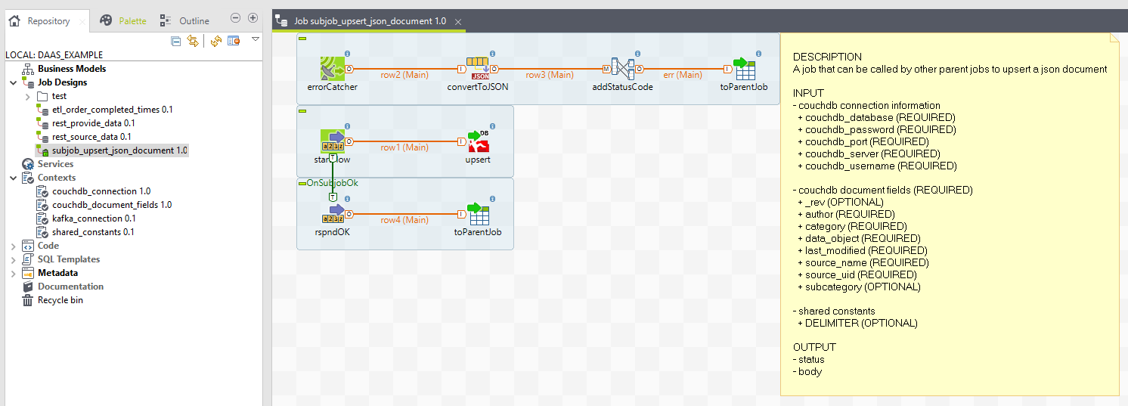
Talend Jobs
A job is a layer of data management flows that can be run.
You can think of a job as a “class with a main()”.

Slide 17
Talend Components
A component is a step in the data management flow that is added to the job and configured.
You can think of a component as a “method”.
Video – 01 add component.webm

Slide 18
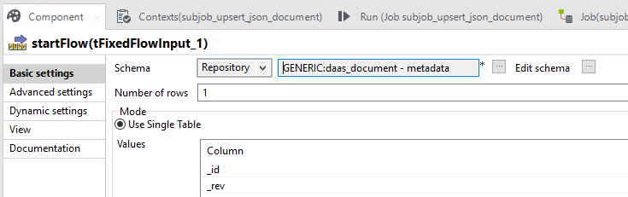
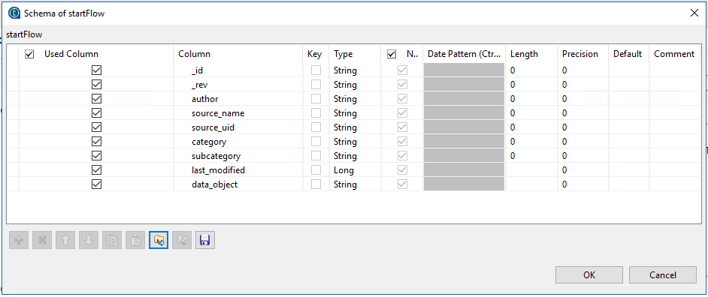
Schemas
A schema defines the data record that follows the data management flow.
You can think of a schema as the “class attributes”.

Slide 19
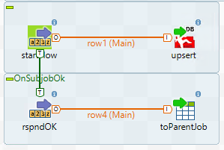
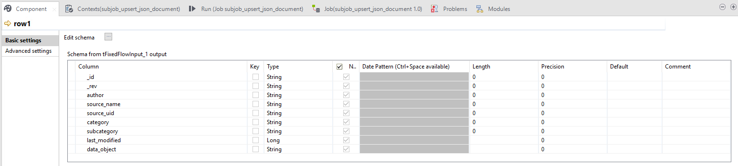
Connectors
A connector defines the flow to follow between components to manage the data. Connectors that pass a data record are called rows and can be referenced as java objects
You can think of a connector as the “glue between the components”.

Slide 20
client request
client request
client request
api layer
service
component
service
component
service
component
service
component
service
component
module
module
module
module
module
A generic snippet of code that can be used in multiple services without forcing a “shared service” – like a library.
… Talend job that updates/inserts a JSON record into couchDB
… subjob_upsert_json_document
message broker
service
component
service
component
service
component
service
component
module
module
module
module

Slide 21

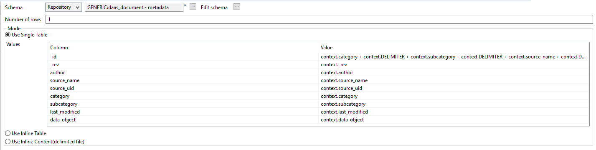

Slide 22

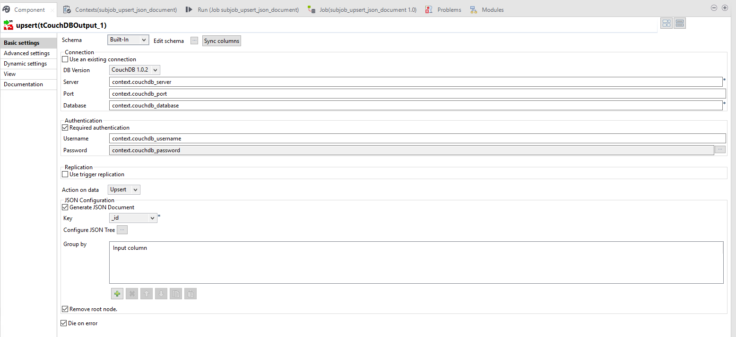

Slide 23

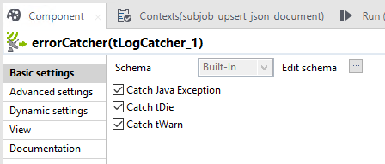

Slide 24
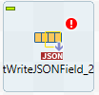
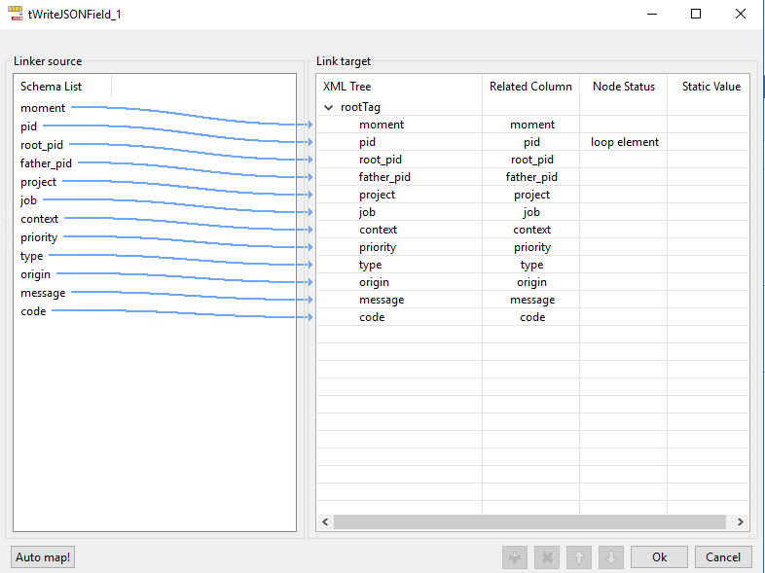
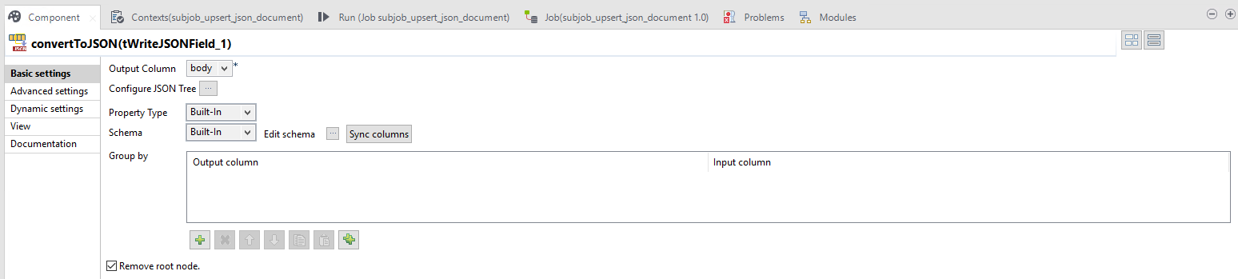

Slide 25
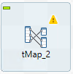
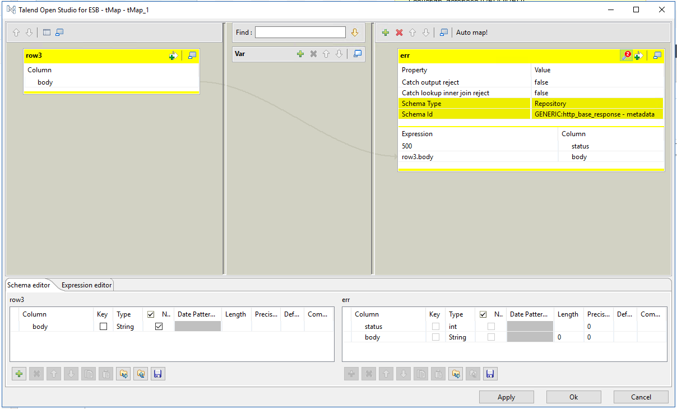
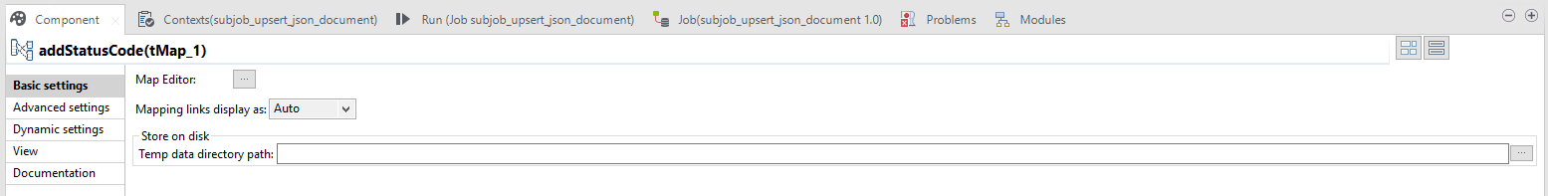

Slide 26

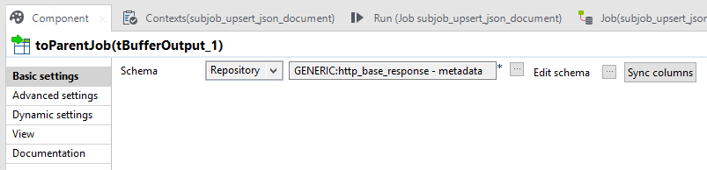

Slide 27
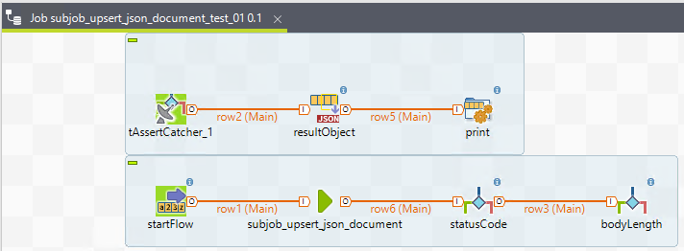
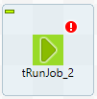
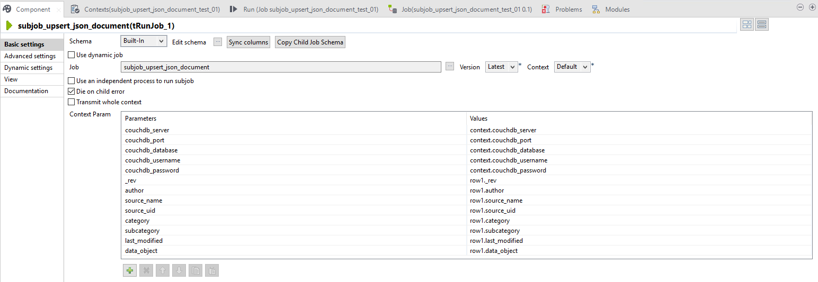
Unit Testing

Slide 28
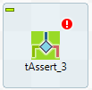
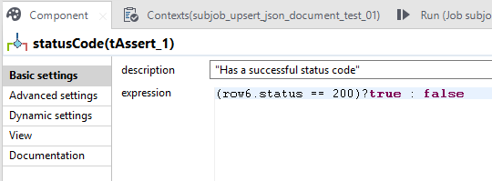
Unit Testing

Slide 29
Unit Testing
Video – 02_subjob_upsert_json_document_test_01.webm

Slide 30
1
DaaS architecture
2
reusable jobs
3
sourcing
4
provisioning
5
consuming

Slide 31
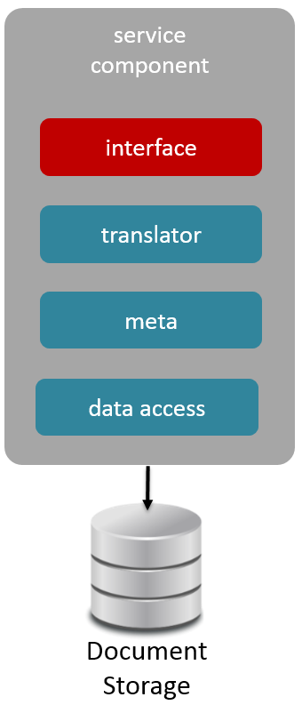
sourcing
real-time
unstructured
confirmation
retrievable

Slide 32
client request
client request
client request
api layer
service
component
service
component
service
component
service
component
service
component
module
module
module
module
module
message broker
service
component
service
component
service
component
service
component
module
module
module
module

Slide 33

service
component
switch(content-type){
case xml:
case csv:
case object:
default json:
}
{
_id : surrogate key,
author : “john smith”,
source_name : “iStore”,
source_uid : “5000”
category : “order”,
subcategory: “clothing”,
last_modified : 1490811072,
data_object : {
“name” : ”dress pants”,
“status” : “new”
}
}
interface
interface
service
component
translator
translator
module
meta
meta
convert
xml to json
csv to json
object to json
data access
data persistence
save
Document Storage

Slide 34
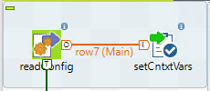

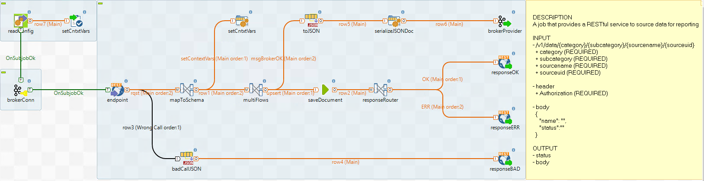




Startup
1. Read configurations
2. Connect to broker
3. Start RESTful service
4. Save request payload to database
Running
5. Respond to the request
6. Send document to broker to be provisioned

Slide 35
service
component
switch(content-type){
case xml:
case csv:
case object:
default json:
}
interface
interface
translator
translator
meta
meta
data access
data persistence
Document Storage

Slide 36
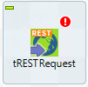
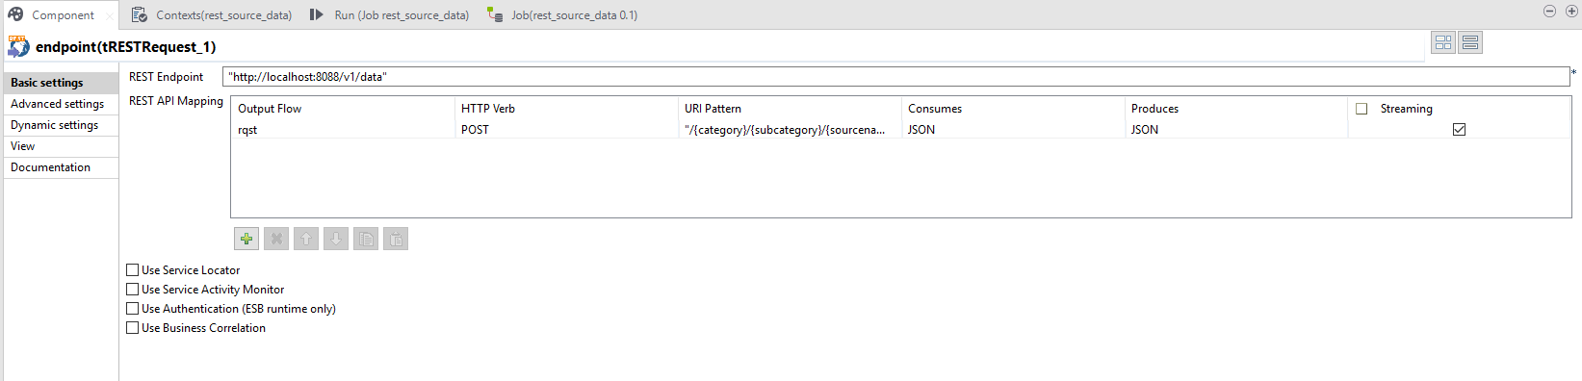


Slide 37
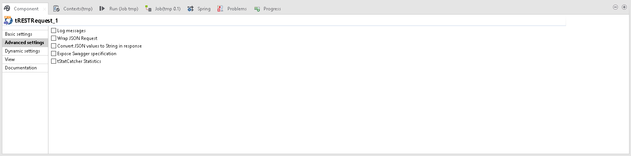
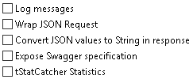

Slide 38
service
component
interface
interface
translator
translator
meta
meta
convert
xml to json
csv to json
object to json
data access
data persistence
Document Storage

Slide 39

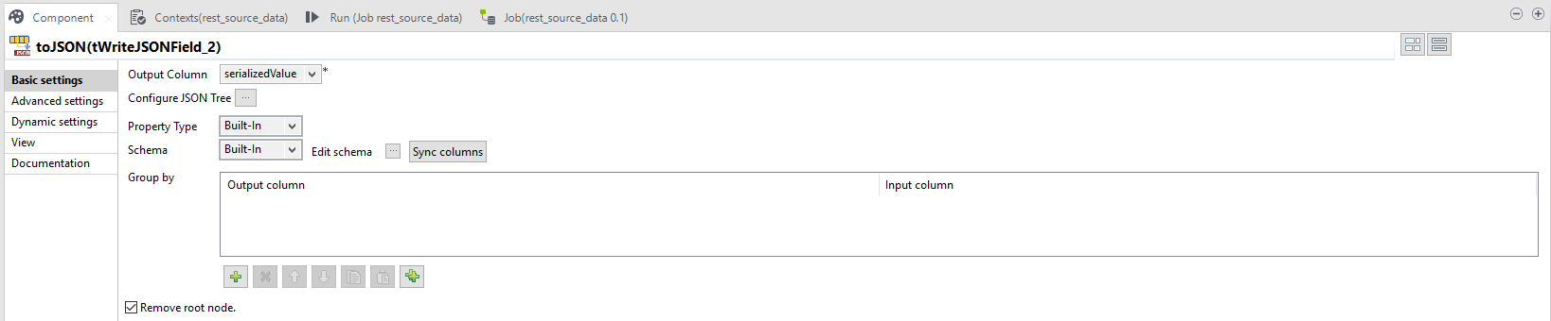
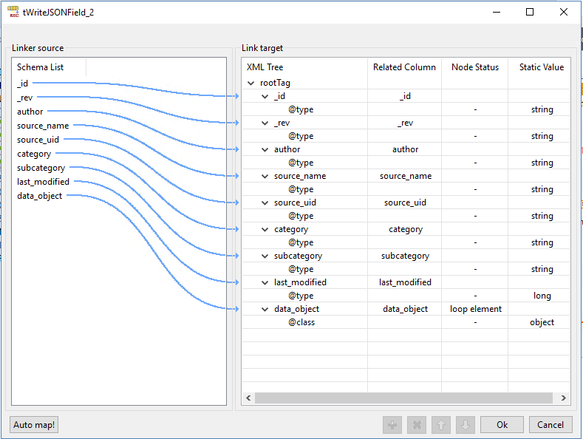

Slide 40
service
component
{
_id : surrogate key,
author : “john smith”,
source_name : “iStore”,
source_uid : “5000”
category : “order”,
subcategory: “clothing”,
last_modified : 1490811072,
data_object : {
“name” : ”dress pants”,
“status” : “new”
}
}
interface
interface
translator
translator
meta
meta
data access
data persistence
save
Document Storage

Slide 41

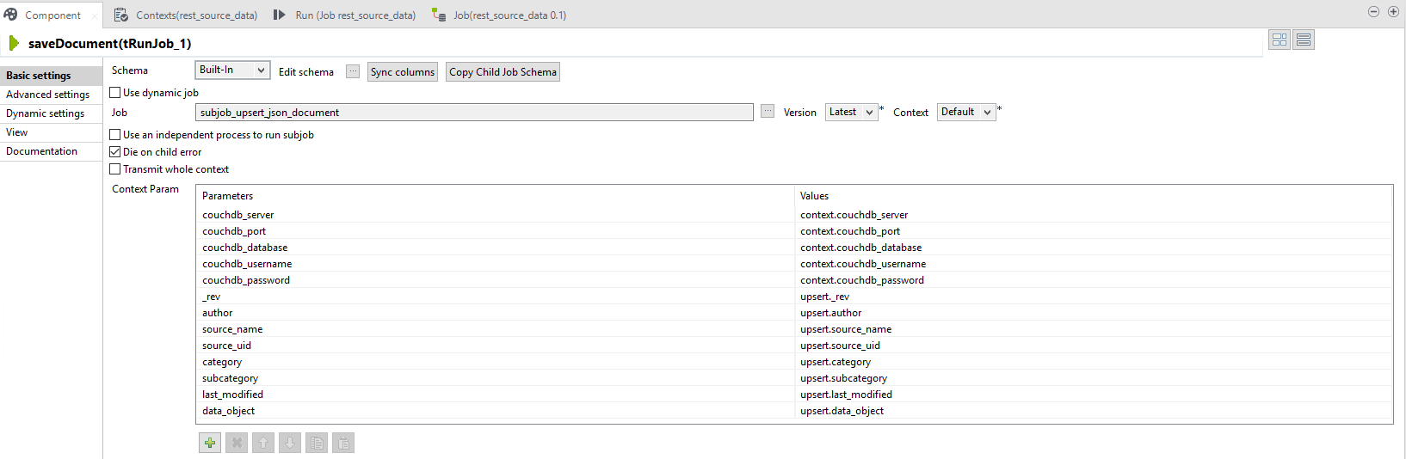

Slide 42

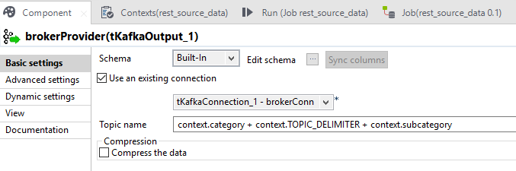

Slide 43
sourcing demo
Video – 03_rest_source_data.webm

Slide 44
1
DaaS architecture
2
reusable jobs
3
sourcing
4
provisioning
5
consuming

Slide 45
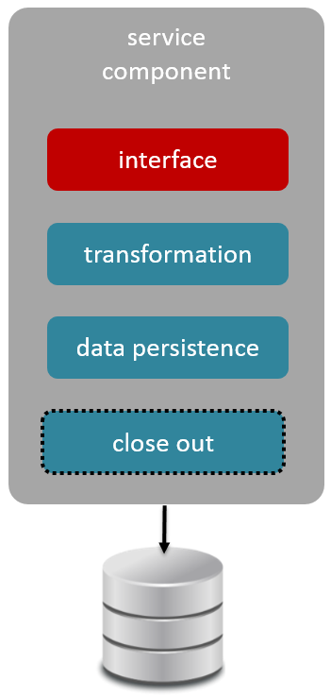
provisioning
real-time
self guided flow
variable load
parallel

Slide 46
client request
client request
client request
api layer
service
component
service
component
service
component
service
component
service
component
module
module
module
module
module
message broker
service
component
service
component
service
component
service
component
module
module
module
module

Slide 47
service
component
meta
data object
save
interface
interface
service
component
transformation
transformation
module
data persistence
data persistence
transformation logic
aggregations
slow changing dimension
fact-less fact
close out
send trigger message
logging
event timestamp
time to process
process name
surrogate key
close out

Slide 48
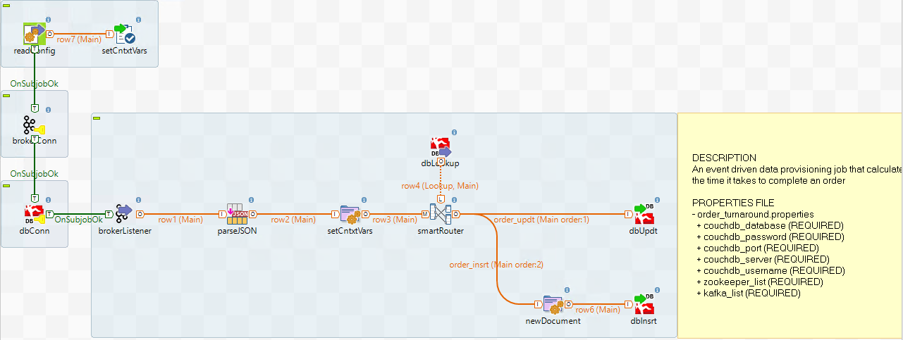

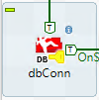



Startup
1. Read configurations
2. Connect to broker
3. Connect to database
4. Start Kafka consumer
5. Parse the JSON message
Running
5. Look up existing report data document
6. Update or insert report data document

Slide 49
service
component
meta
data object
interface
interface
transformation
transformation
data persistence
data persistence
close out
close out

Slide 50

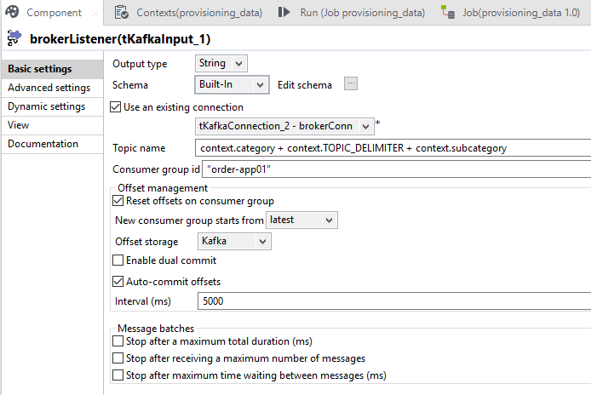

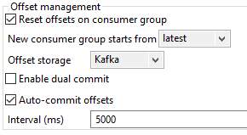


Slide 51
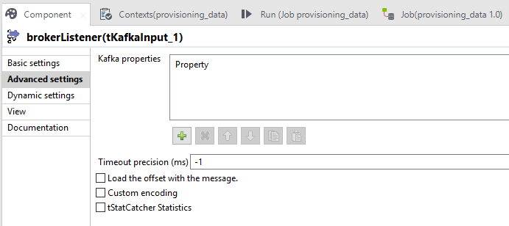


Slide 52
service
component
interface
interface
transformation
transformation
data persistence
data persistence
transformation logic
aggregations
slow changing dimension
fact-less fact
close out
close out

Slide 53
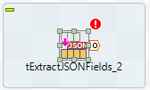
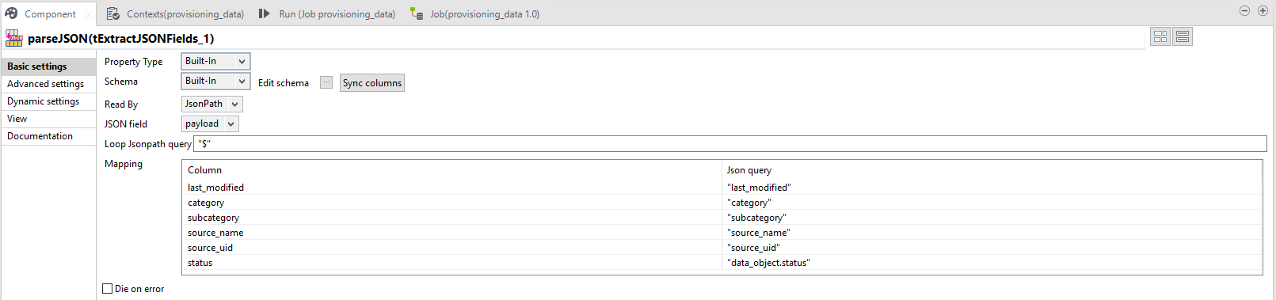
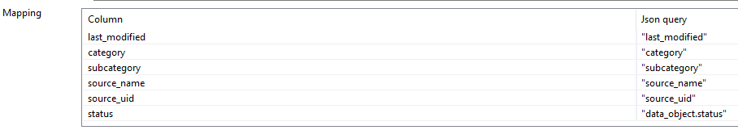

Slide 54
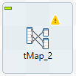
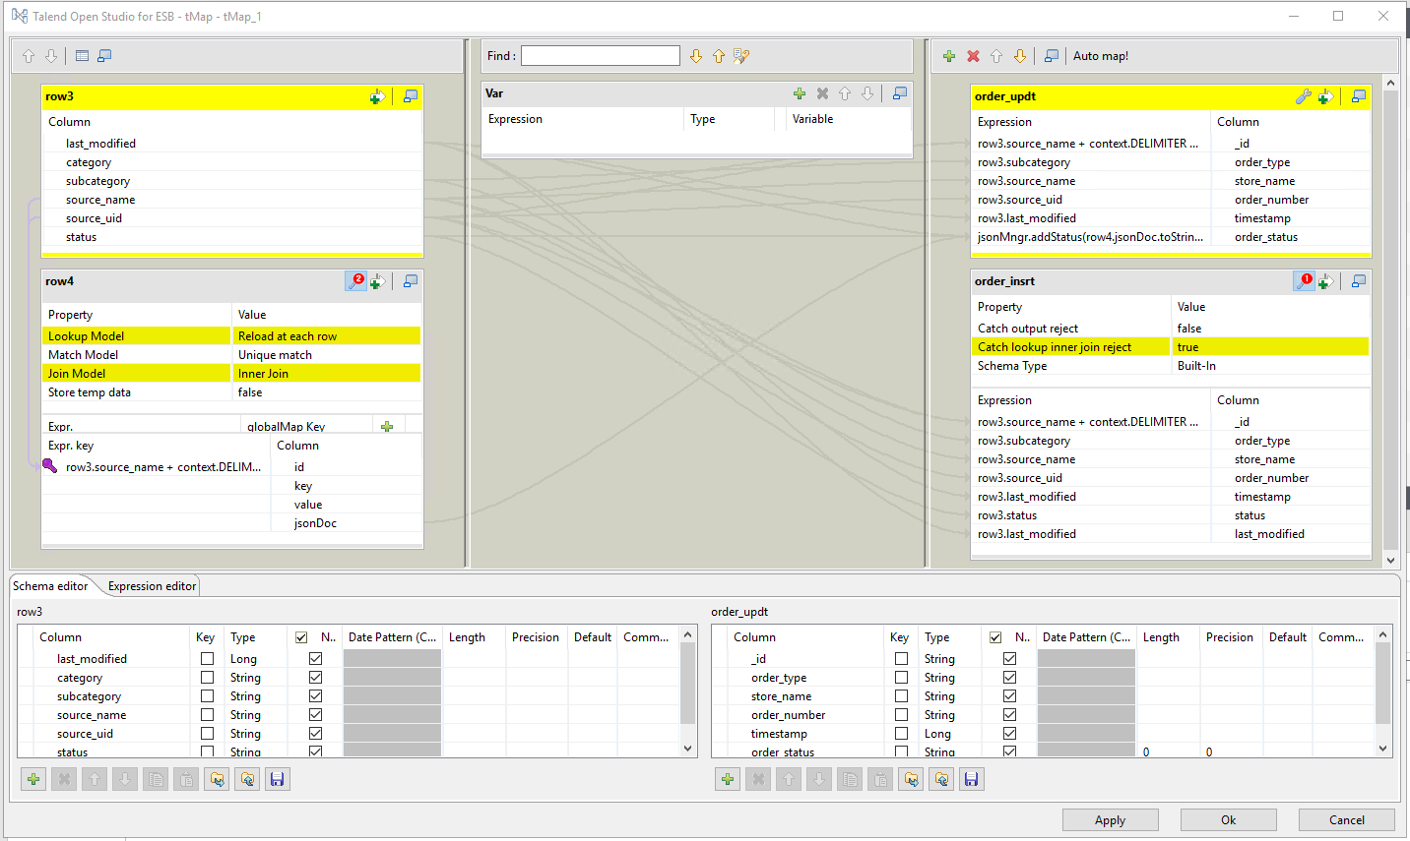

Slide 55
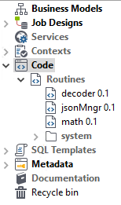
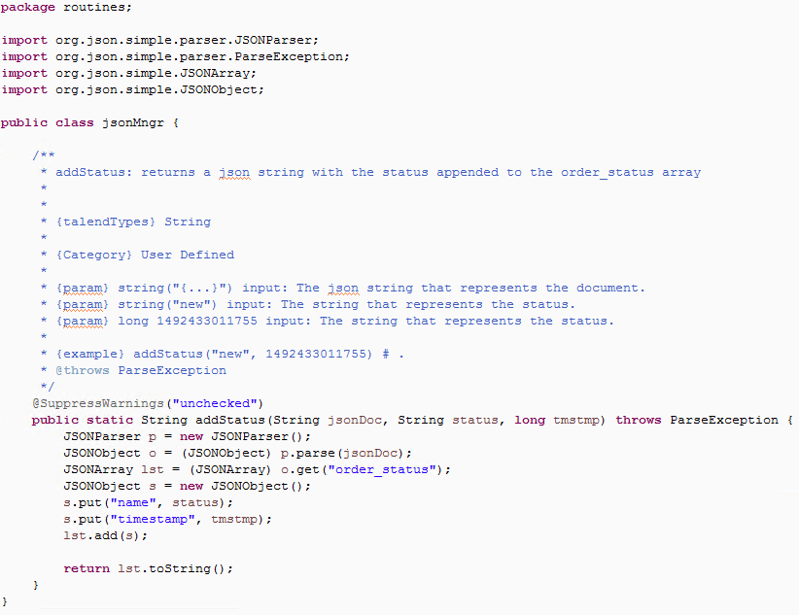

Slide 56
service
component
save
interface
interface
transformation
transformation
data persistence
data persistence
close out
close out

Slide 57

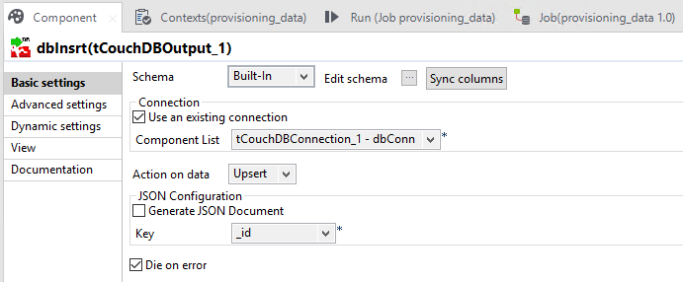


Slide 58
service
component
interface
interface
transformation
transformation
data persistence
data persistence
close out
send trigger message
logging
event timestamp
time to process
process name
surrogate key
close out

Slide 59

Send a message to trigger the next provisioning plugin
system flow
topic
topic
topic
service
service
service

Slide 60
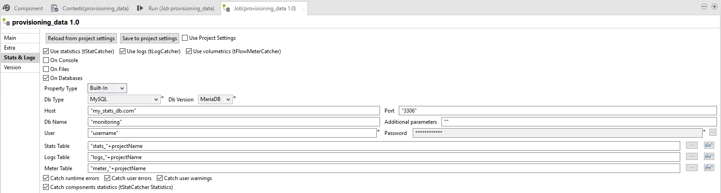
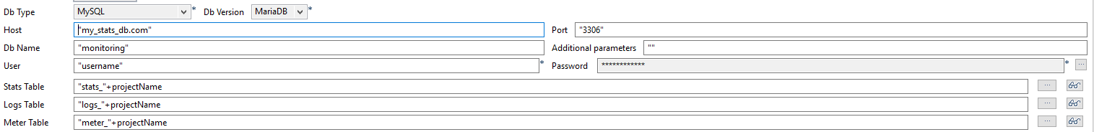
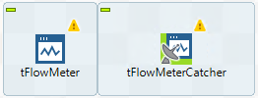
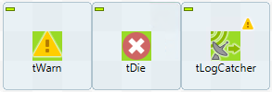

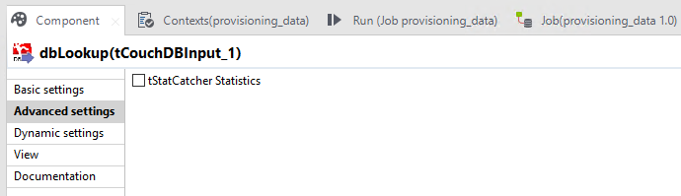
Logging and monitoring of performance, load, etc.

Slide 61
provisioning demo
Video – 04_provisioning_data.webm

Slide 62
1
DaaS architecture
2
reusable jobs
3
sourcing
4
provisioning
5
consuming

Slide 63
consuming
real-time
variable endpoints
variable load
managed access

Slide 64
client request
client request
client request
api layer
service
component
service
component
service
component
service
component
service
component
module
module
module
module
module
message broker
service
component
service
component
service
component
service
component
module
module
module
module

Slide 65
service
component
access management
switch(content-type){
case xml:
case csv:
case object:
default json:
}
retrieve data
filter
sort
simple aggregates
interface
interface
service
component
translator
translator
module
data persistence
data persistence
convert
xml to json
csv to json
object to json
close out
logging
event timestamp
time to process
close out

Slide 66



Startup
1. Read configurations
2. Connect to database
3. Start RESTful service
4. Query the database
Running
5. Generate response body
6. Respond to the request

Slide 67
service
component
access management
switch(content-type){
case xml:
case csv:
case object:
default json:
}
interface
interface
translator
translator
data persistence
data persistence
close out
close out

Slide 69
service
component
interface
interface
translator
translator
data persistence
data persistence
convert
xml to json
csv to json
object to json
close out
close out

Slide 70


Slide 71
service
component
retrieve data
filter
sort
simple aggregates
interface
interface
translator
translator
data persistence
data persistence
close out
close out

Slide 72



Slide 73



Slide 74
service
component
interface
interface
translator
translator
data persistence
data persistence
close out
logging
event timestamp
time to process
close out

Slide 76




Slide 77
consuming demo
Video – 05_rest_consuming_data.webm

Slide 78
“Got It!”
“Darn”
“Almost”
“Doh!”
GO!

Slide 79
Our Scenario
The report is proving to be very useful. But could you add a drop-down to select an order number?
Sure thing.

